Slide 1

Predictive Analytics for Healthcare – Chronic disease prediction
Created by – Team 3
Tanmay Zope (002767087)
Saloni Rane (002756771)
Shreeyash Lahane (002743020)
Parth Kalani ()

Slide 2
1) Title slide - come up with a good title of the project - 1 slide
2) Outline in bullet points the organization of the rest of the deck - 1 slide
3) Describe the problem you are trying to solve - 1-2 slide
4) Data source description - 1-2 slides
5) Technical approaches and algorithms - 3-4 slides
6) Implementation environment and code example - 2-3 slides
7) Results - 1-2 slides
8) Performance comparison of 4 techniques and evaluation - 1-2 slides
9) Conclusion and future directions - 1 slides

Slide 3

Table of contents:
Problem Statement
Dataset Description
Data Cleaning and Preprocessing
Linear Regression
Logistic Regression
Random Forest Classification
Support Vector Machine Classification
Implementation & Code Snippets
Results and Visualizations
Performance Evaluation
Conclusion

Slide 4
Problem Statement
Developing models and choosing the most optimal one that accurately classifies risk using a more automated approach and greatly impacting chronic disease prediction
Analyze large amounts of medical data, identify patterns, and use this information to make predictions to improve the accuracy and speed of disease diagnosis, thereby helping medical professionals to provide better care and treatment to patients. Thereby, enabling us to significantly streamline the process.

Slide 5
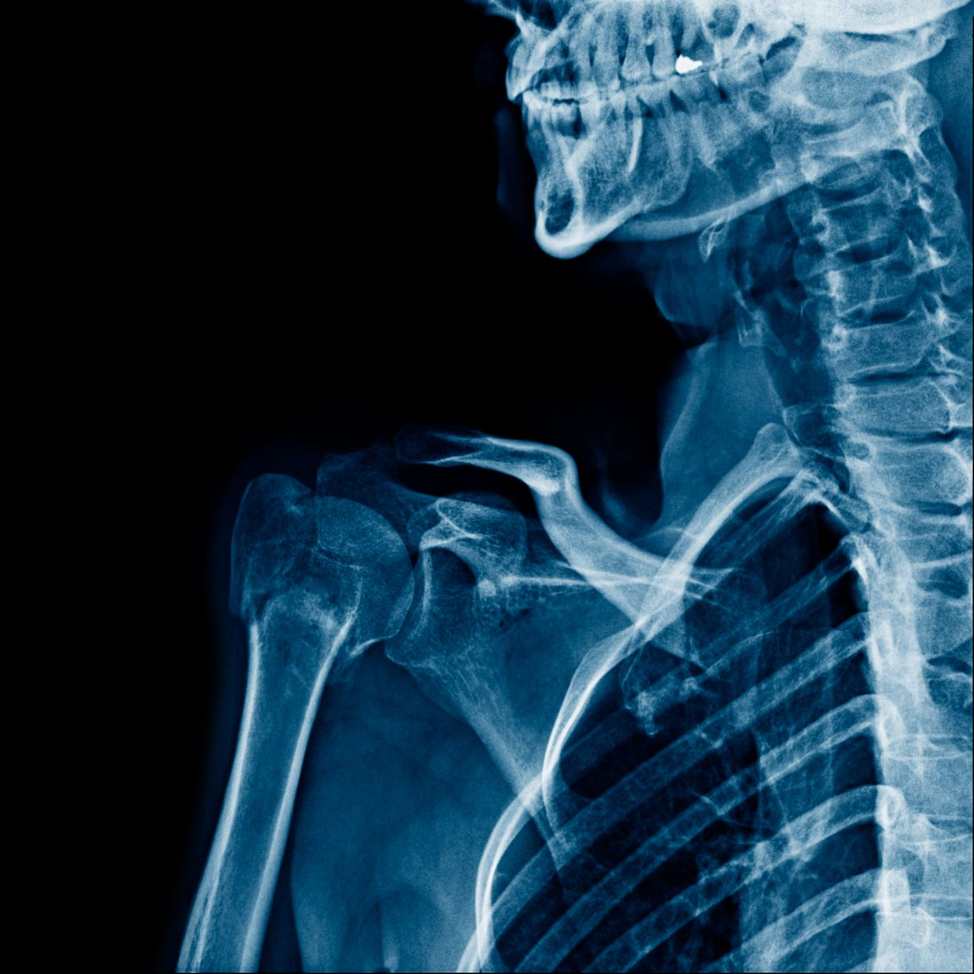
Data Description
The Complete Dataset includes two CSV files - one for training your model and the other for testing it.
Each CSV file contains 133 columns, with 132 columns representing different symptoms experienced by a person and the last column indicating the prognosis.
These symptoms are linked to 42 different diseases, which can be classified based on the set of symptoms.
To build a model, you need to train it on the training data and then evaluate it on the testing data.

Slide 6
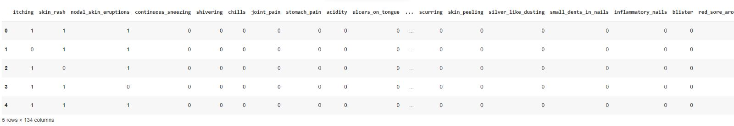
Data Description
Dataset

Slide 7

Technical Approach
The steps listed below could be used to apply five different machine learning approaches for categorization on the provided dataset:
Load the training as well as testing datasets
Clean up the data by eliminating any irrelevant columns or features that could not be helpful for the categorization process.
Additionally implemented feature scaling & data cleaning.
Divide the training dataset into subsets for training and validation to evaluate the effectiveness of the various machine learning models.
Use the training dataset to apply five different machine learning approaches for classification, including SVM and decision trees. Among other models include logistic regression, k-nearest neighbors, random forest, and naive Bayes
Used relevant evaluation metrics, such as accuracy, precision, recall, and F1-score, to assess each model's performance on the validation subset.
Based on the evaluation measures, choose the top-performing model and use the testing dataset to evaluate how well it performs with omitted data.
Lastly, give a thorough comparison of the effectiveness of the various machine learning methods that were employed.

Slide 8

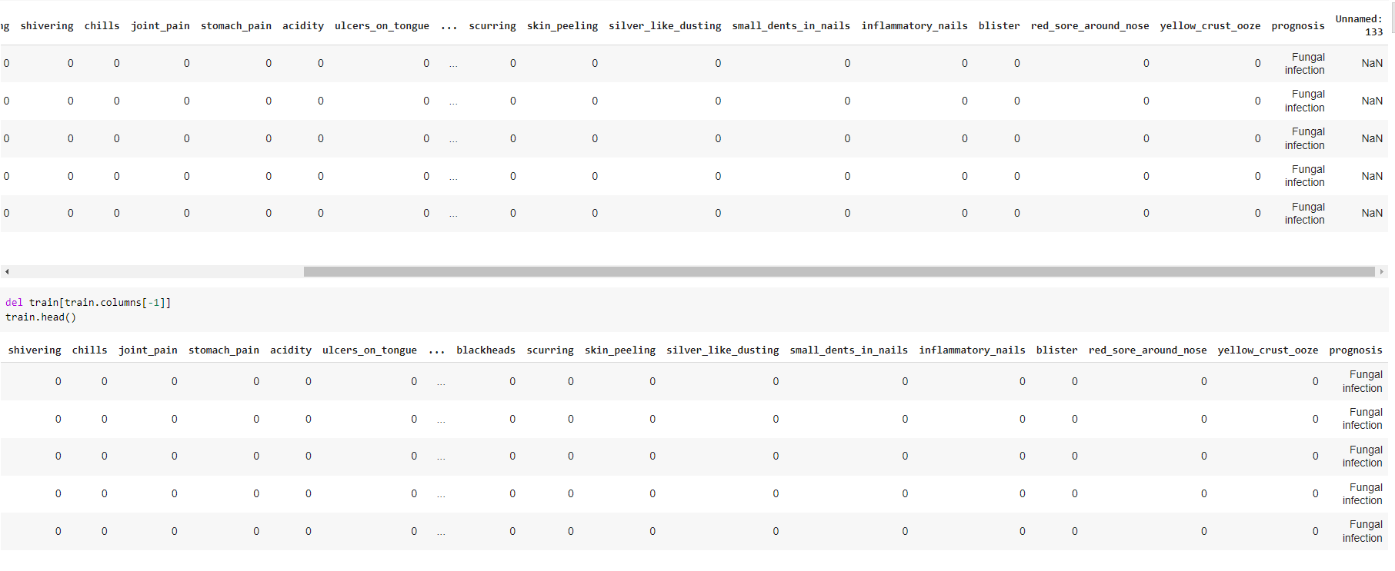
Data Cleaning and Preprocessing
Displaying the first 5 rows (by default)
Dropping the last column as it has Nan value

Slide 9
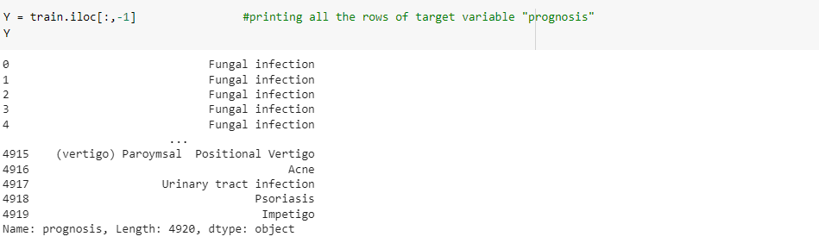
Data Cleaning and Preprocessing
Checking the null values per row
Check the description of DataFrame
Checking if any value is missing per variable (column)
Displaying basic information of DataFrame
Remove the rows with null values

Slide 10
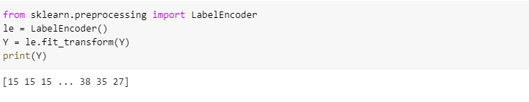
Data Cleaning and Preprocessing
Separating the Dataset and Results as X & Y
Encoding Object type in Y

Slide 11
Data Visualization of Feature selection

Slide 12
Data Visualization of Feature selection

Slide 13
Data Visualization of Feature selection

Slide 14
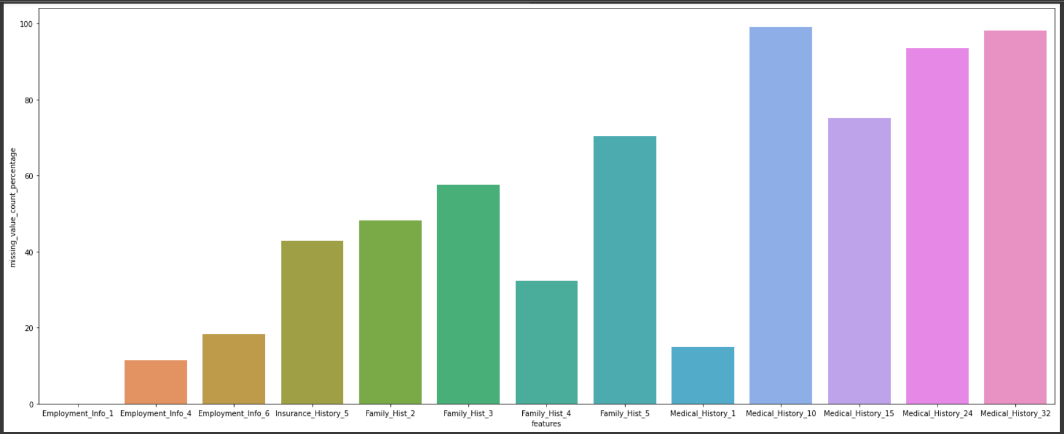
Feature Selection
Percentages of null values

Slide 15
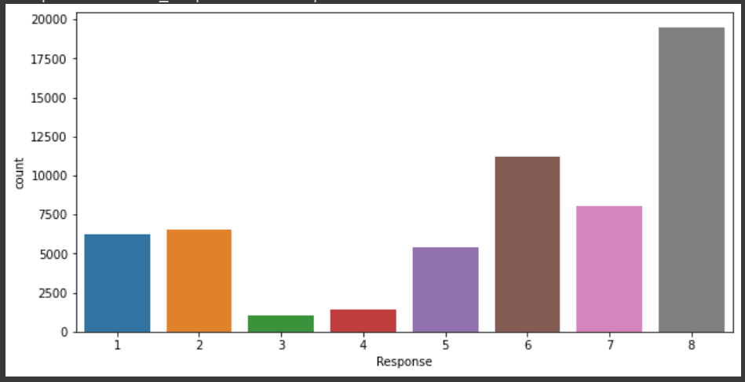
Data Cleaning and Preprocessing
Perform label encoding on the Product_Info_2 variable
Classified Response variable into groups of 0 (1-4), 1 (5-7), 2 (8)
Distribution of the output variable

Slide 16

Data Cleaning and Preprocessing
Creating a new columns by summing all the Medical_Keyword columns
Dropping all the Medical_Keyword columns
Getting rid of the outliers
Normalizing the data

Slide 17
Linear Regression
Predicts the value of the dependent variable based on the independent variables
Relatively simple model
Attempts to model the relationship between two variables by fitting a linear equation
Y = a + bX1 + cX2 + dX3 + e
Model Accuracy = 35.47%

Slide 18

Logistic Regression
Supervised machine learning model
It is a classification model
Outcome is probability - bounded between 0 and 1
Applying logit transformation on the odds
Performing Ordinal Logistic Regression as Response variable is ordinal
Model Accuracy = 46.02%

Slide 19

Random Forest Classification
Supervised machine learning algorithm
Consists of many decision trees that operate as an ensemble
Each individual tree predicts a class. The class with maximum number of votes becomes the model’s prediction
Individual trees protect each other from their individual errors i.e., low correlation
Therefore, yields better results
Model Accuracy = 43.38%

Slide 20
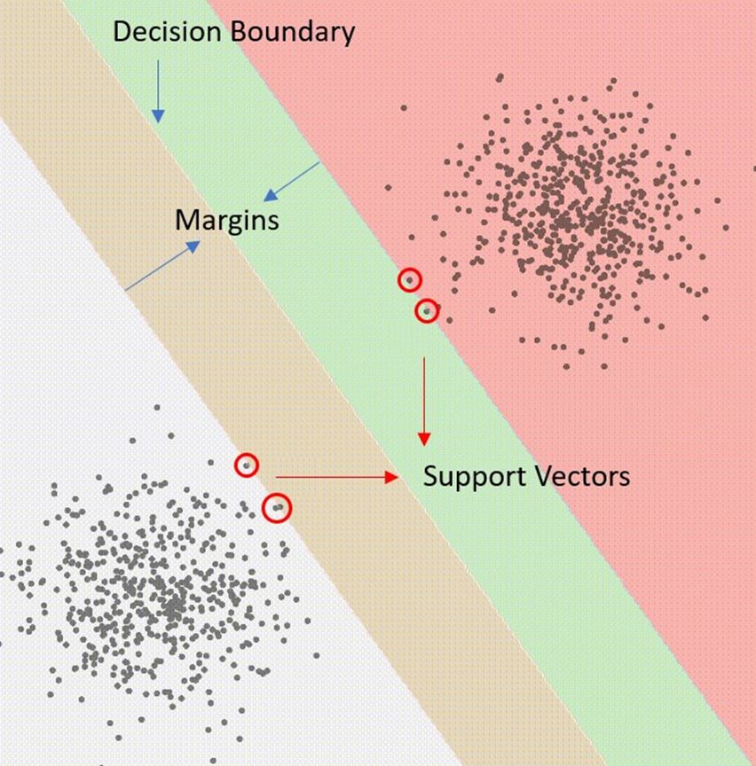
Support Vector Machine
Supervised machine learning model
Uses classification algorithm to classify data
Works well with small datasets (in 1000’s)
Given a pair of (x,y) coordinates, classify them accurately into either group
SVM utilizes the existing data points to output a hyperplane that best separates the given points – decision boundary
Best hyperplane – whose distance to each nearest element is the largest
Model Accuracy = 44.97%

Slide 21
Performance Evaluation
 | Linear Regression | Logistic Regression | SVC | Random Forest Classifier
Test Accuracy | 35.47 | 46.02 | 44.97 | 43.38
Train Accuracy | 33.65 | 81.18 | 81.17 | 81.46

Slide 22

Conclusion
Based on these scores, Logistic Regression, Decision Tree, and Random Forrest have the highest accuracy scores of 89.6%.
SVM with a linear kernel also has a high accuracy score of 89.6%.
Naïve Bayes has a slightly lower accuracy score of 89%, while KNN and SVM with a polynomial kernel have the lowest scores of 88.8 and 83.5, respectively.
Therefore, if we are to choose a single model based on accuracy alone, we would likely choose Logistic Regression, Decision Tree, or Random Forrest.
However, it's important to keep in mind that accuracy is not the only metric to consider, and other factors such as model complexity and interpretability may also be important.

Slide 23
Thank you!

